Slide 1
Working Like Nehemiah
Nehemiah 13:31 – “Remember me, O my God, for good.”

Slide 3
“That which hath been is that which shall be; and that which hath been done is that which shall be done: and there is no new thing under the sun. Is there a thing whereof it may be said, see, this is new? It hath been long ago, in the ages which were before us” (Ecclesiastes 1:9-10).
“Black Death” spread across Europe in the years 1346-1353, killing an estimated 60 million.
Smallpox outbreak of 1520 killed 5 - 8 million people.
Yellow fever outbreak over the course of spring and summer of 1878 killed an estimated 13,000 - 20,000.
The “Third Plague” of 1855 ultimately led to more than 12 million deaths in India and China, with about 10 million in India alone.
The Spanish flu pandemic of 1918-1919 killed millions. Older estimates say it killed 40 - 50 million people while current estimates say 50 - 100 million people worldwide were killed. In the United States alone, about 28% of the population suffered, and 500,000 to 675,000 died.
Ecclesiastes 7:14 says, “In the day of prosperity be joyful, and in the day of adversity consider.”

Slide 4
Restoration Of God’s People
Jeremiah 27:22; cf. 25:11-12

Slide 5
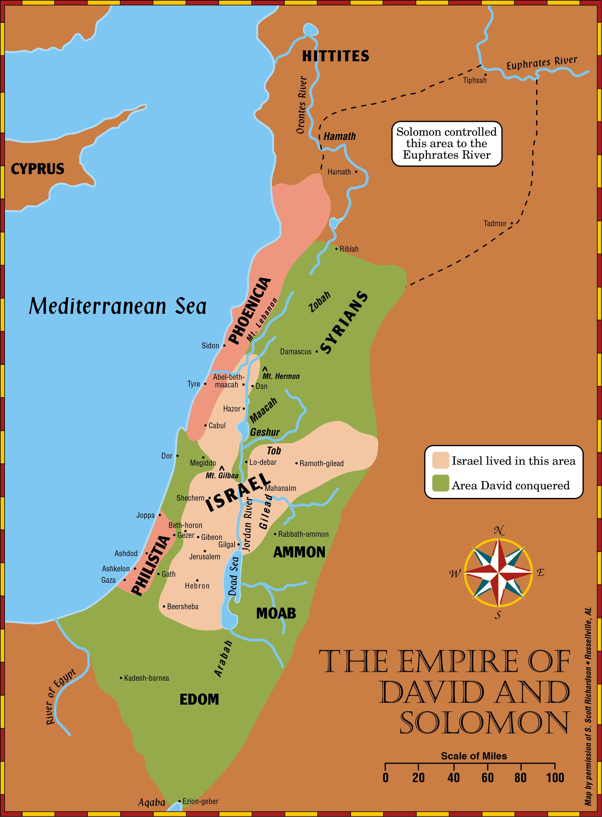

Slide 6
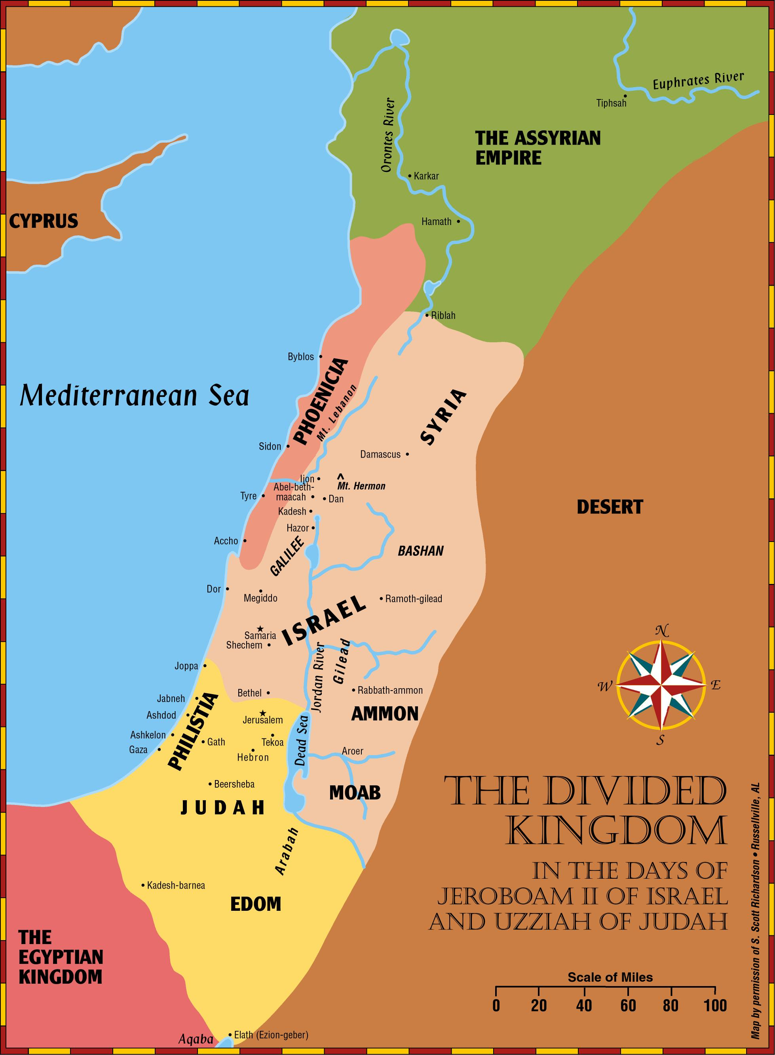

Slide 7
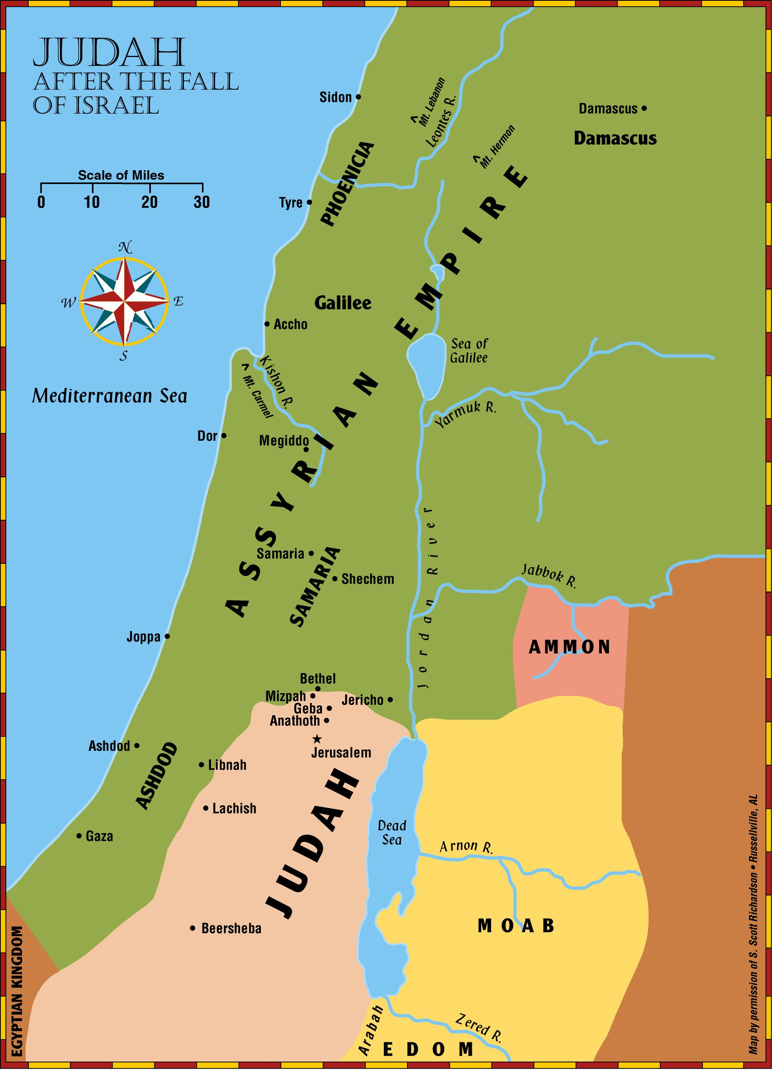
Isaiah 10:5-11

Slide 8
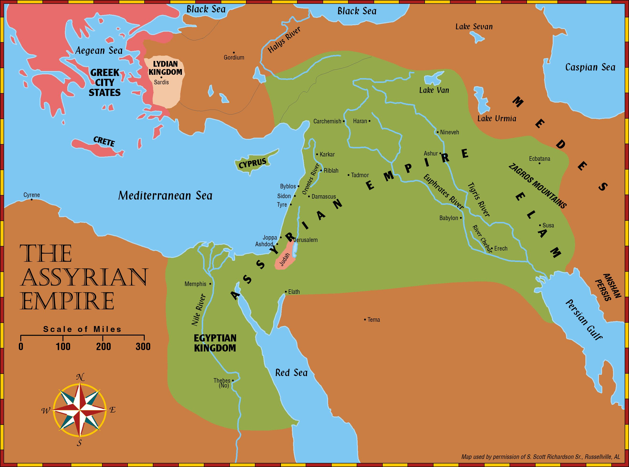
2 Kings 18-19

Slide 9
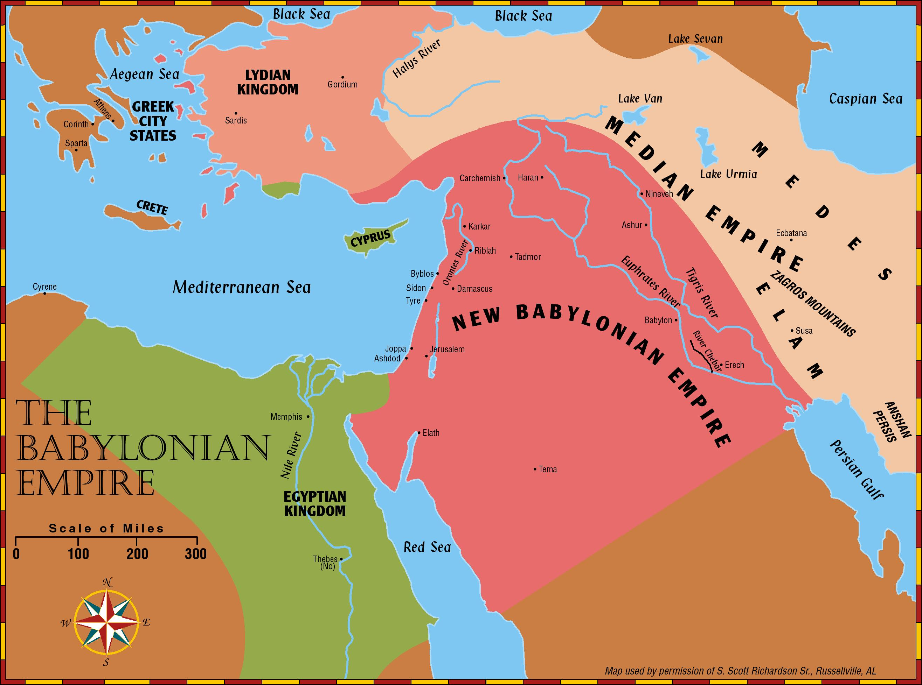
Jeremiah 25:8-11

Slide 10
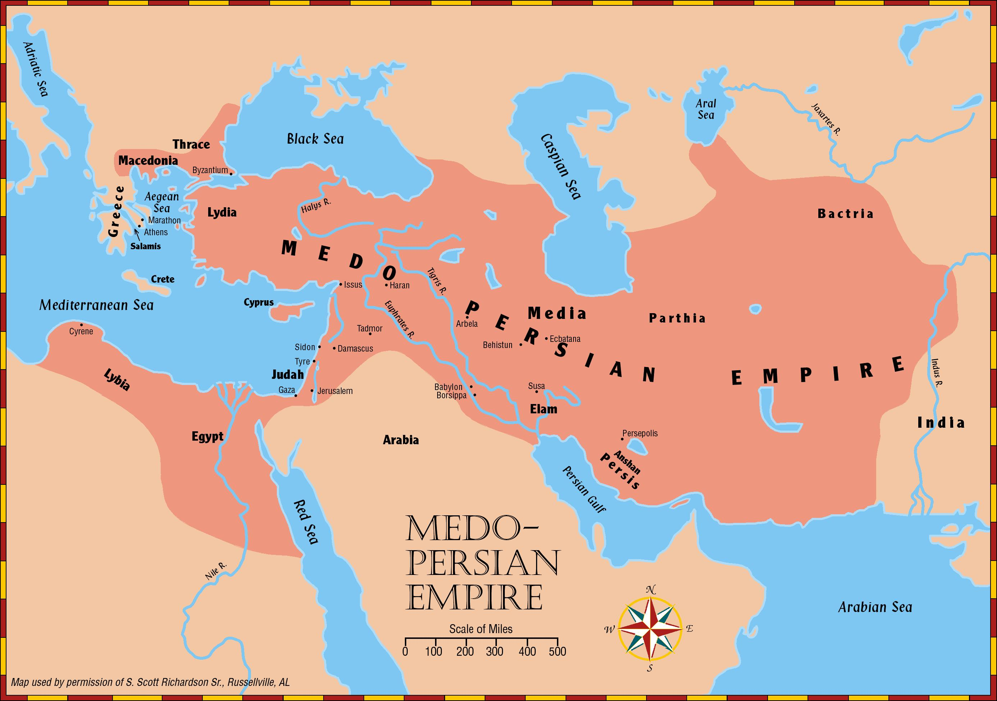
Isaiah 44:27-45:1-4

Slide 11
Background of Haggai and Nehemiah – Ezra 1-6
Captivity
606 B.C. First captives taken by Nebuchadnezzar. Daniel 1:1-2
597 B.C. Second Group (10,000) taken to Babylon. 2 Kings 24:10-16; Ezekiel 1:1-3
586 B.C. Jerusalem falls, temple destroyed. 2 Kings 25:1-21
539 B.C. Babylon falls to Medes and Persians. Daniel 5: 25ff; Isaiah 44:27-45:1-4

Slide 12
Background of Haggai and Nehemiah – Ezra 1-6
Restoration
536 B.C. Cyrus issues a decree (538) for the Jews to go back to Jerusalem; after 70 years.
(cf. Jeremiah 25:11; 29:10-14)
  Almost 50,000 return under the leadership of Zerubbabel (2 Chronicles 36:21-23; Ezra 1)
516 B.C. The temple is completed. Ezra 6:15
458 B.C. Ezra led a second remnant of 2,058 Jews to Jerusalem. Ezra 8:1-34
444 B.C. Nehemiah lead a third remnant back.
Nehemiah 2

Slide 13
Persian Kings
These rulers cover the period of restoration during the time of: Ezra, Nehemiah, Esther, Haggai, Zechariah, and Malachi.
Cyrus (559-529) Conquered Babylon in 539 B.C. with Darius the Mede. Daniel 5:30-31
Cambyses (529-522) Also called “Artaxerxes” Commanded work on temple to cease.
Ezra 4:7, 11, 23

Slide 14
Persian Kings
These rulers cover the period of restoration during the time of: Ezra, Nehemiah, Esther, Haggai, Zechariah, and Malachi.
Darius I (522-486) Authorized the completion of temple. Ezra 4:24-6:15, Book of Haggai
Xerxes (485-465) Also called “Ahasuerus”
– Esther was his queen, Book of Esther.
Artaxerxes (465-425) Authorized Nehemiah to rebuild Jerusalem, Ezra 7; Book of Nehemiah.

Slide 15
Nehemiah
A Man Of Action

Slide 16
Interest In His Brethren
1:2 Asked concerning the condition of his brethren.
1:4ff Prays for the people.
1:11 Prays for himself.
2:4 Prays for the right answer.
Power of prayer. James 5:16

Slide 17
Preliminary Preparation
2:3-8 Petitions the king
Send ME to Jerusalem.

Slide 18
The Work Of Rebuilding
2:9-20 Preparation –
  Views the city, reveals his mission.
  Ridicule.
Chapter 3 – Assignments given for the work.

Slide 19
The Work Of Rebuilding
The Zeal Of The Work.
  4:1-3 Ridicule.
  4:6 “The people had a mind to work.”
  cf. Haggai
  4:9, 16 Watch.
  4:17 Worked with one hand and held their weapons with the other hand.
  4:18 Trumpet blower by Nehemiah … leadership and cooperation.
  4:20 Faith in God. “Our God will fight for us.”

Slide 20
The Work Of Rebuilding
The Greatest Interference To Their Work Was Internal Strife. 5:1-6
5:9 “The thing that ye do is not good.”
  Ephesians 4:3; Psalms 133:1;
  1 Thessalonians 5:12-13; Galatians 5:15
5:12 People promise to repay.
5:14-19 Example of Nehemiah.

Slide 21
The Work Of Rebuilding
Uncompromising Work.
  First effort to get Nehemiah to compromise: 6:1-9
    “I am doing a great work … I cannot come …”
  Second effort to get Nehemiah to compromise: 6:10-14
The Work Finished. 6:15 Fifty two days.

Slide 22
The Work Of Registering and Educating The People
7:1-73 People registered according to genealogy.
8:1-8 Law read to the people.
8:10ff People react to the reading of the law. cf. Ezra 9-10
9 – Public confession of sin.
10 – People make a covenant to keep the law.

Slide 23
The Work Of Populating The City
11 – One out of every ten to dwell in Jerusalem.

Slide 24
Dedication Of The Walls
12:27 A grand occasion. Great celebration!
  12:31 The princes of Judah went upon the wall.
  12:43 Day of rejoicing, singing, praying, thanksgiving. “Heard even afar off.”

Slide 25
“When The Cat Is Away …”
Nehemiah 13:6
13:4-5 Tobiah, given quarters in the temple courts by Eliashib the high priest (13:28).
13:10-11 Levites abandoned their posts in the temple.
13:15-17 People profaned the Sabbath day. (cf. Chapter 10)
13:23ff People had engaged in mixed marriages.
Ezra (9:3) versus Nehemiah.

Slide 26
Conclusion:
We should be like Nehemiah.
Work or act now, cry later.
Develop the mind to work, despising internal strife.
Learn to accept the example and zeal of Nehemiah.
13:31, “Remember me, O my God, for good.”

